Slide 1
“Project Stream”
Card game like “Hearthstone”
Each card is represented by a twitch streamer / league of legends champion
Cards have talents, roles, characteristics..
Worked with a web developer that manage learn2play.fr
Designed the database of the card game
Developed Unity application about the collection of cards

Slide 2
Why this project ?
Serious games / Gamification
Database
Manipulate data
Discover Web development and API's
+ Potential of the project (Narkuss)

Slide 3
How did I developed this project ?
Worked with a team to define the card game (rules, cards effects...)
Designed the database & implement it with the web developer
Developed the Unity application, matching with the already existing database from L2P website

Slide 4
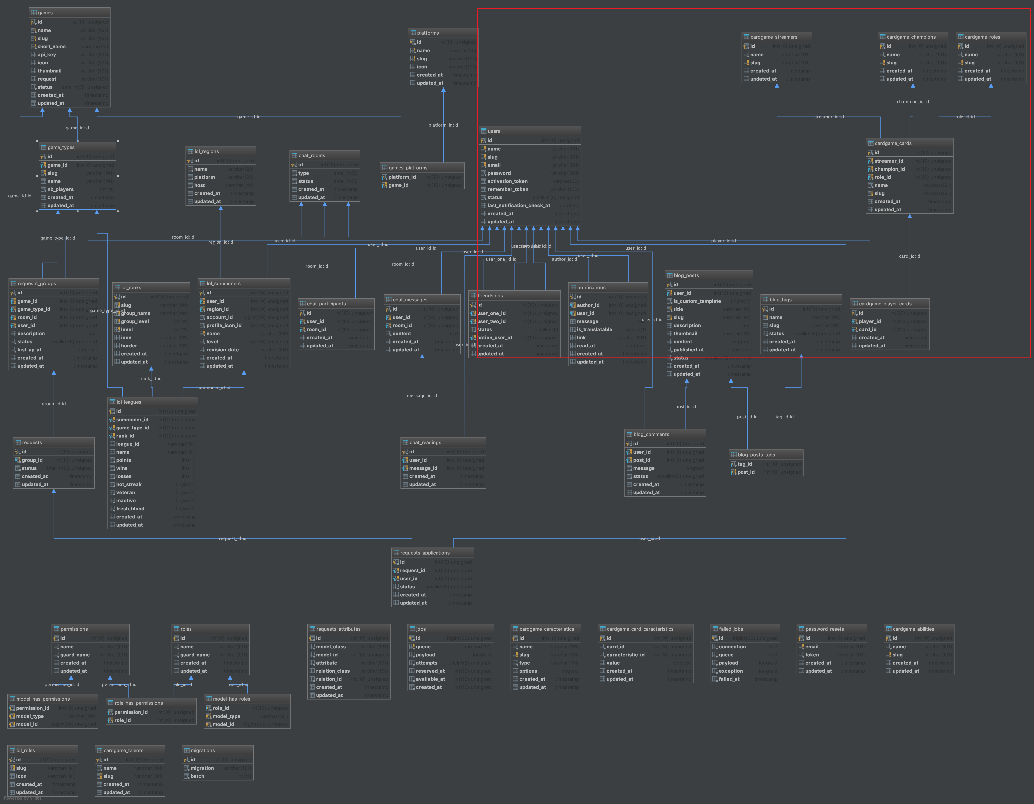
Database of L2P website

Slide 5
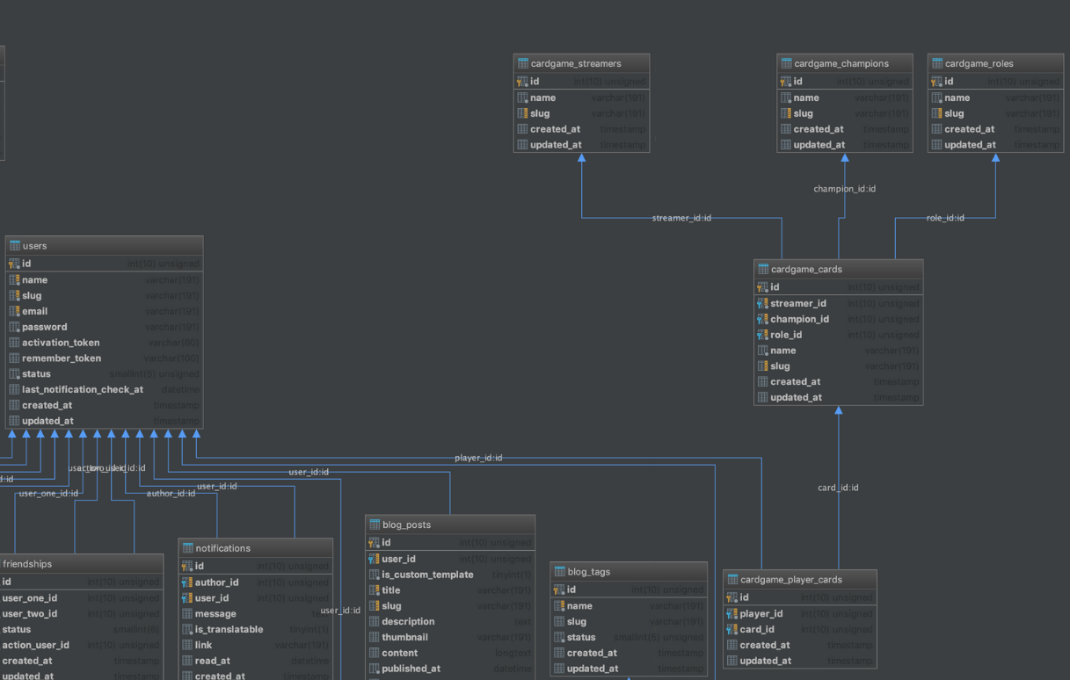
Database of the card game

Slide 6
Routes of the API
// Card game routes
$router->group([
'prefix' => 'cardgame',
'namespace' => 'CardGame',
], function () use ($router) {
$router->get('card/{page?}/{limit?}', 'CardController@index');
$router->post('register-card/{card}/{player}', 'CardController@register');
$router->get('player/{player}/{page?}/{limit?}', 'PlayerController@index');
$router->get('streamer', 'DataController@streamer');
$router->get('champion', 'DataController@champion');
$router->get('role', 'DataController@role');
$router->get('talent', 'DataController@talent');
$router->get('ability', 'DataController@ability');
$router->get('caracteristic', 'DataController@caracteristic');
});
(new GameRoute())->gameApiRoutes();
});

Slide 7
Example : register a card
public function register(Card $card, Player $player): Response
{
$card->players()->attach($player->id);
return $this->player($player);
}

Slide 8
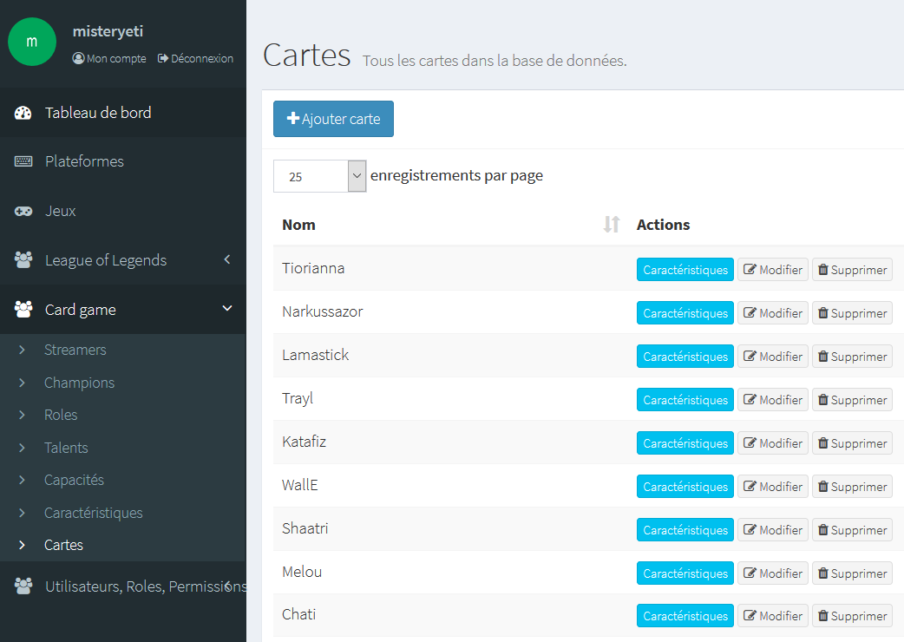
Generate data : The dash board

Slide 9
GET & POST on Unity
Problems :
Find a way to execute GET & POST requests
Make them generics ?
Return data from the requests. Still need generic
Allow the developer to execute methods :
      before/after executing the request
      In case of failure/successful request
=> Needed lot of re-factorization

Slide 10
Generic GET method
How ?
Use Delegates
Use Coroutines
Generic objects
Convert Json data to the generic object
Execute method before/after the request
Execute method in case of failure/successful request

Slide 11

Generic GET method
//Get generic method
public static IEnumerator RequestCoroutineGet<T>(string url, Action<T> getObject = null, Action actionFail = null, Action actionBefore = null, Action actionAfter = null)
{
if (actionBefore != null)
actionBefore();
UnityWebRequest www = UnityWebRequest.Get(url);
yield return www.SendWebRequest();
if (www.isNetworkError || www.isHttpError)
{
actionFail();
}
else
{
string jsonResult =
System.Text.Encoding.UTF8.
GetString(www.downloadHandler.data);
T obj = JsonHelper.GetJsonObject<T>(jsonResult);
getObject(obj);
if (actionAfter != null)
actionAfter();
}
}

Slide 12
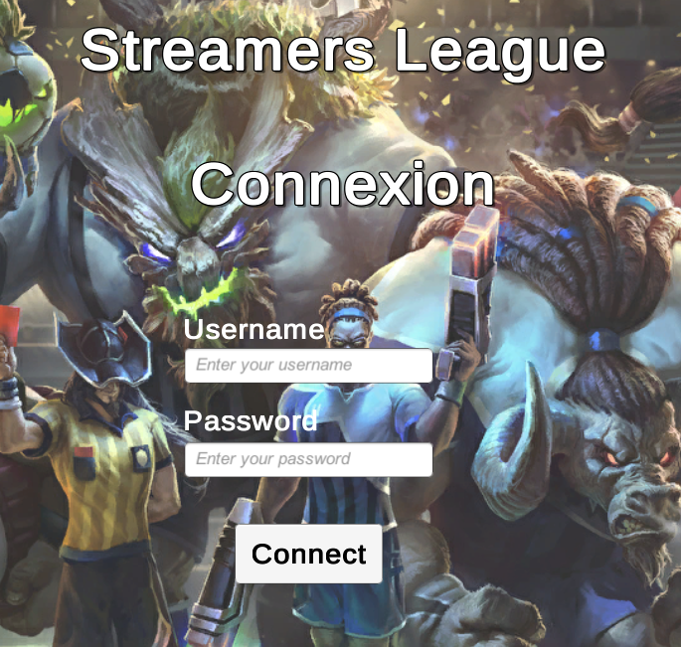
Example : The authentication

Slide 13
Example : The authentication
What do we want after clicking on “connect” ?
Disable the connect button + Show loading bar
Execute the request :
    If fail → Do not connect + Enable button + Remove loading bar
    If success → Load all cards THEN connect (Load scene) + Remove loading bar
    All parts need to be separated → One task at a time

Slide 14
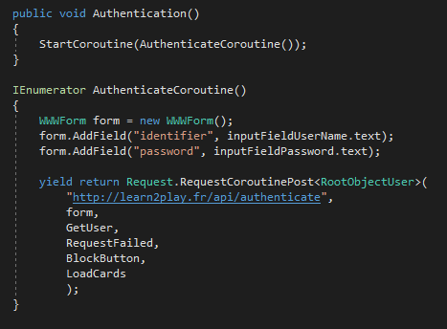
Example : The authentication

Slide 15
Example : The authentication
Before

Slide 16
Example : The authentication
Fail
Before

Slide 17
Example : The authentication
Collect data
Fail
Before

Slide 18
Example : The authentication
Collect data
Fail
Before
After

Slide 19

Example : The authentication
Before executing the request
BlockButton

Slide 20
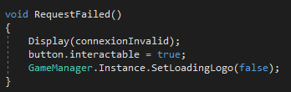
Example : The authentication
In case of failure
RequestFailed

Slide 21

Example : The authentication
In case of success :
Collect data (Generic object → RootObjectUser)
GetUser

Slide 22
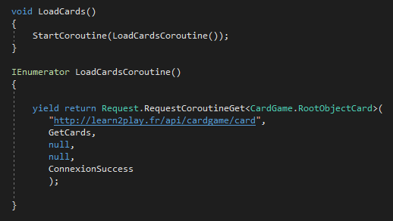
Example : The authentication
In case of success :
Load all cards → Execute another request to get the user’s cards
LoadCards
Repeat the process to execute any other request !

Slide 23
What I’ve learned
Some aspect of web development
API Request through Unity
Use generics
Architect a project
Work with a remote team
=> Will help me finding a job in serious game industry

Slide 24
What’s Next ?
Online purchase of cards packs
Customized selection of cards in the collection
Find other way to optimize requests ?
The end

